Slide 1


Analysis of smoking status impact on molecular mechanisms of SARS-CoV-2 viral entry through single-cell sequencing experiments
Author: Mateusz Urbanek
Supervisor: PhD Anna Papież
Notes:
Note: After adding your pictures, right click on it and “Send To Back”.

Slide 2

01
Introduction
What is Single Cell data, and why is it important?
02
Research background and motivation
What is the impact of smoker’s status on SARS-COV-2
Table of contents
03
Workflow methodology
How do we approach analysis of Single Cell Data
04
Discussion
Time for question

Slide 3
01
Introduction
What is Single Cell data, and why is it important?
Notes:
Note: After adding your pictures, right click on it and “Send To Back”.

Slide 4
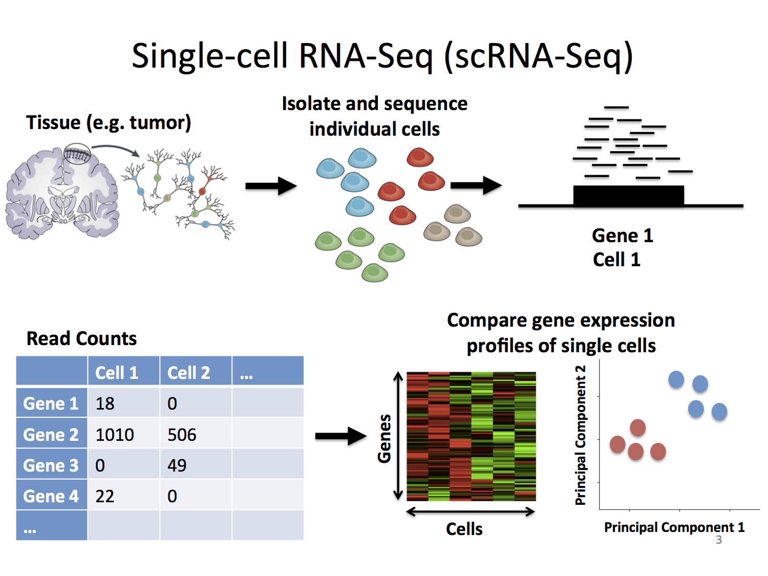
01 - Introduction
Single Cell RNA-seq
RNA sequencing (RNA-seq) - genomic approach for the detection and quantitative analysis of messenger RNA molecules in a biological sample and is useful for studying cellular responses.
Single Cell RNA sequencing (scRNA-seq) - cell are sorted then RNA-seq is performed on specific cell types separately.
Stephanie Hicks Welcome to the World of Single-Cell RNA-Sequencing https://speakerdeck.com/stephaniehicks/welcome-to-the-world-of-single-cell-rna-sequencing?slide=3

Slide 5
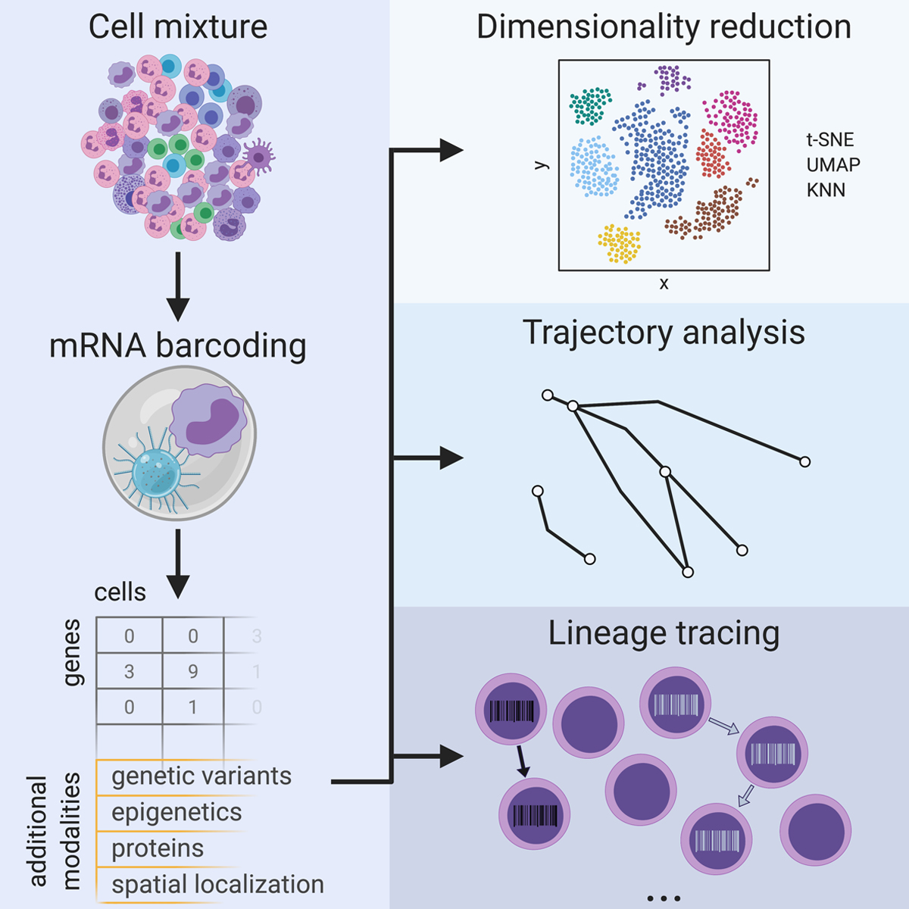
01 - Introduction
Why we need Single Cell RNA-seq?
Single-cell RNA sequencing (scRNA-seq), for example, can reveal complex and rare cell populations, uncover regulatory relationships between genes, and track the trajectories of distinct cell lineages in development.
Jean Acosta, Daniel Ssozi and Peter van Galen
Single-Cell RNA Sequencing to Disentangle the Blood System
https://www.ahajournals.org/doi/10.1161/ATVBAHA.120.314654

Slide 6
02
Research background and motivation
What is the impact of smoker’s status on SARS-COV-2

Slide 7
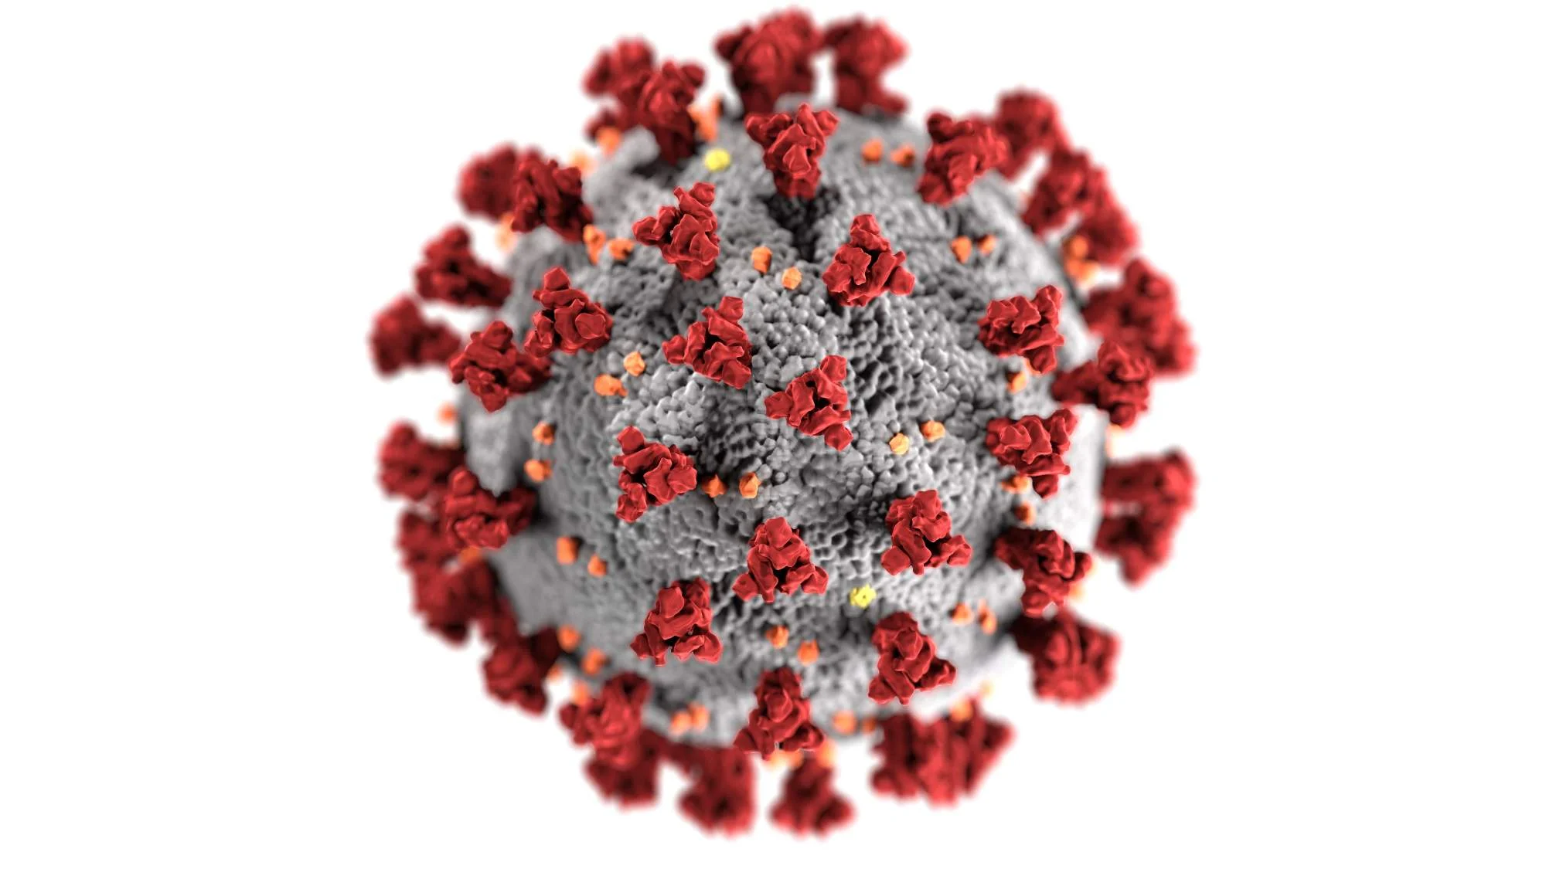
02 - Research background
Why this topic?
COVID-19 is a popular topic nowadays
Huge research potential
There will be more and more data in the future
Personal reasons – family member (smoker) suffered complications after COVID-19

Slide 8
02 - Research background
State of art
Single-cell analysis identifies shared and distinct immune features of COVID-19, Influenza and other community-acquired pneumonia
https://doi.org/10.7554/eLife.69661
Single-Cell Transcriptomic Analysis of Human Lung Reveals Complex Multicellular Changes During Pulmonary Fibrosis II
https://doi.org/10.1164/rccm.201712-2410OC
Integrated analyses of single-cell atlases reveal age, gender, and smoking status associations with cell type-specific expression of mediators of SARS-CoV-2 viral entry and highlights inflammatory programs in putative target cells
https://doi.org/10.1101/2020.04.19.049254

Slide 9
02 - Research background
Data and results
Classic scRNA-seq analysis of the SARS-CoV-2/Pneumonia data
Comparative analysis of the results of scRNA-seq SARS-CoV-2/Pneumonia and partially public data acquired processed in the integrated meta analysis.

Slide 10
03
Workflow
How do we approach analysis of Single Cell Data

Slide 11
03 - Workflow
Data loading
Helper function for loading type agnostic files – works with CSV, TSV, and HDF5 files
Calculating number of expressed genes and building a histogram out of the data

Slide 12
03 - Workflow
QC metrics
Calculate number of Mitochondrial and Ribosomal RNA for each cell
Plotting histogram of both metrics

Slide 13
03 - Workflow
QC metrics
Plot number of molecules detected per cell (nCounts_RNA), number of genes detected per cell (nFeatures_RNA) and other metrics as violin plot to visualize distribution between datasets.
Calculate additional QC metrices for nFeatures_RNA and nCounts_RNA
Min
Max
Median
Standard Deviation
95th quantile

Slide 14
03 - Workflow
QC metrics
Plot feature scatters to visualize cut-off areas:
Delete all cells with more than 5% of ribosomal and mitochondrial RNA
Delete cells with less than 500 genes detected per cell
Delete cells with more than 95th quantile of molecules

Slide 15
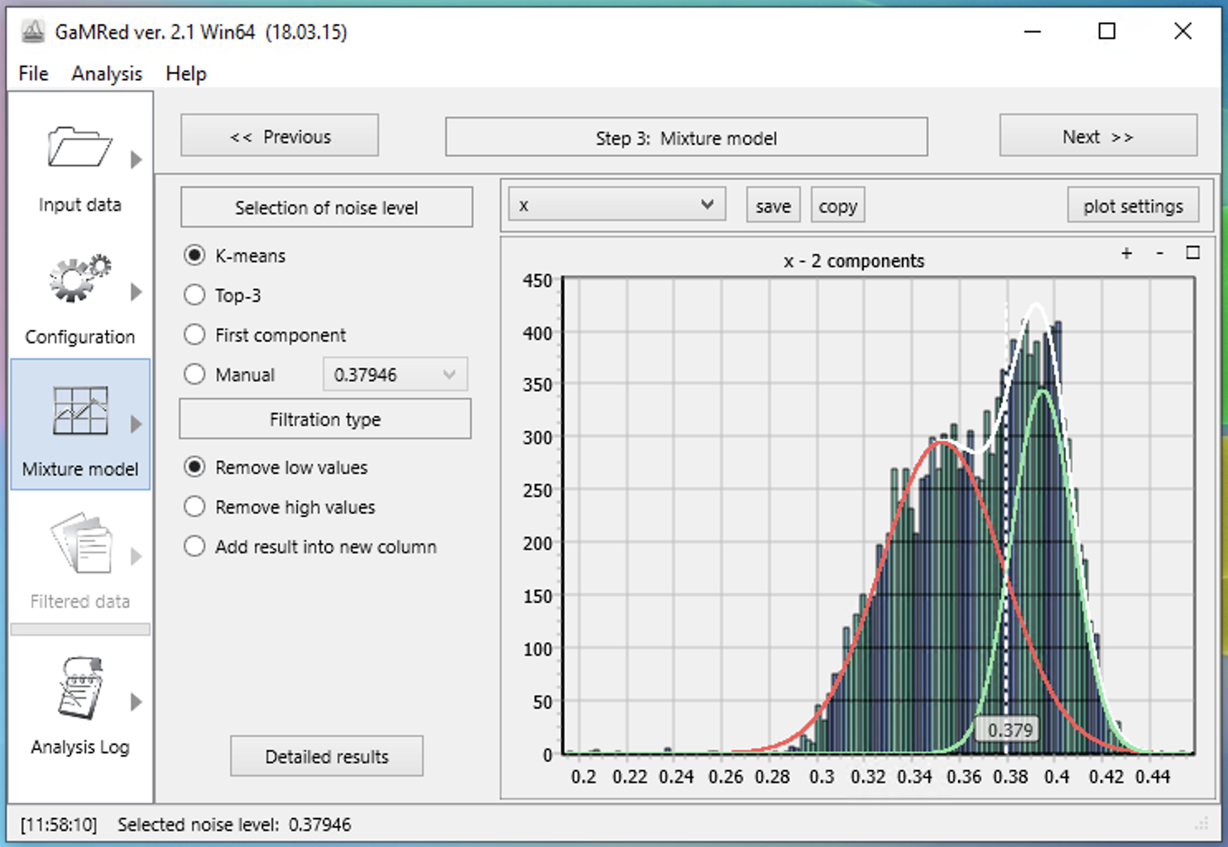
03 - Workflow
Normalization and scaling
Normalize the data (log normalization)
Calculate variances for each gene
Using Gaussian Mixture Models determine the threshold for selecting the genes with highest variance
Scale the data

Slide 16
03 - Workflow
Performing Dimensionality Reduction
Running PCA and ICA
Creation of Elbow Plot based on PCA
Determination of inflection point

Slide 17
03 - Workflow
Clustering
Cluster cells
Dimensionality reduction using UMAP (and tSNE)
Plot UMAP

Slide 18
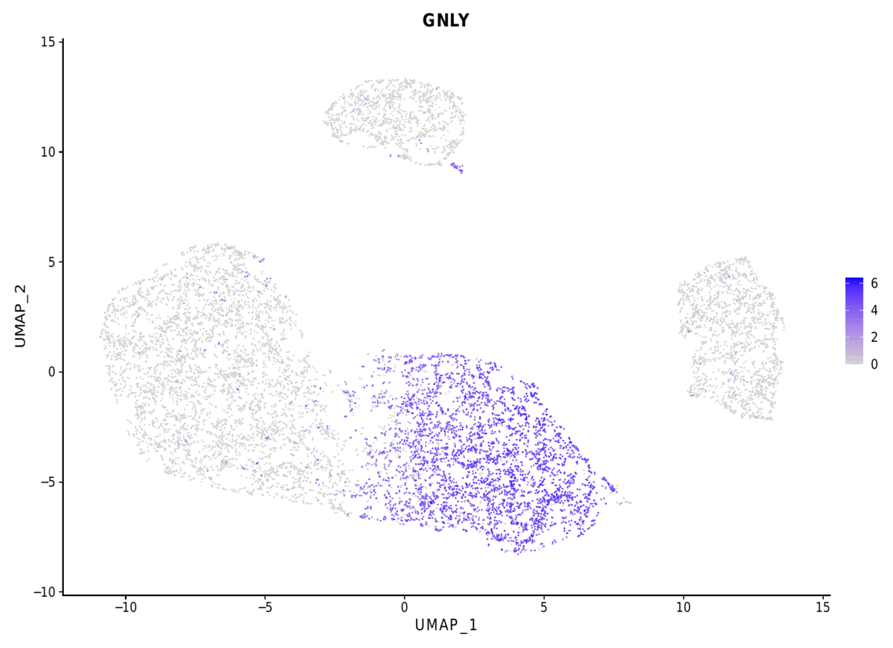
03 - Workflow
What else needs to be done?
Marker gene detection
Cell type annotation
Compare the obtained results with the result achieved in reference publication

Slide 19
04
Discussion
Time for questions

